Slide 1

Aquaroom
Project Proposal
Ethan Thomas, Jake Stewart, Gabriel Smith-Dalrymple, Gayathri Ramasamy, & Adrienne Co

Slide 2
Mechanics
Key Experiences
“Sense of accomplishment or pride for winning best tank”
“Feelings of joy and anticipation in sharing what you make and seeing what others make”
“Finding your (user’s) Zen”
“Feeling of self-discovery through player creativity”
Goal: Create aquarium aquascapes and exhibits to unlock more decorations and gallery space
Major Mechanics:
Design and decorate
Competing for “best tank” against other users’
Caring for fish

Slide 3
Selling Points
What We’re Working With
Puts a spin on existing fish care games
Focus on aquascaping and the outside environment
Game does not ask for or require lots of user data and shows few mandatory ads
e.g. Access to contacts or internet history
Game can be enjoyed slowly (without paying real money) or quickly (with real money)
Game never forces you to think you must pay in order to move forward
Genre: Design/Art, Idle, Virtual Pet
Platform: Android and iOS
Target Audience: Casual Gamers (People who play mobile games on avg. 24 min a day)

Slide 4
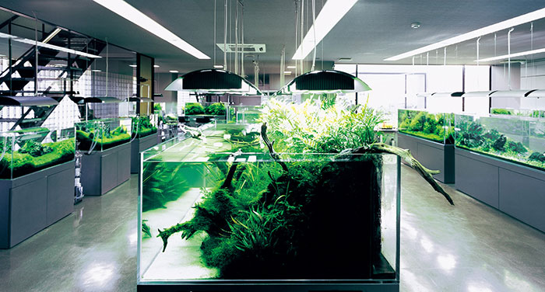


Setting
References
Aquarium Gallery
Viridi by Ice Water Games (Visuals)
Aquascaping: Aquarium Landscaping Like a Pro by Moe Martin (Visual Inspiration)

Slide 5
Related Games
Fish Live
Developed by CanaryDroid in 2014
Has almost 600k views and rating of 4.3 out of 5 on Google Play
Critics often comment about attractive graphics, large variety of fish and slow movement of game
Fish Paradise - Aquarium Farm
Developed by Orca Studios in 2017
Has almost 6k views and rating of 4.5 out of 5 on Google Play
Critics often comment about the many permissions needed and the hurdles to completing tasks
Fish Farm 3 - 3D Aquarium Simulator
Developed by BitBros Inc. in 2019
Has over 6k views and rating of 4.5 out of 5 on Google Play
Critics often comment about information collection through surveys

